Slide 1
Scene Classification
Update 1
Piter Garcia Karina Damico Pauline Martial

Slide 2
Karina:
Gabor descriptor

Slide 3

Gabor descriptor
Typically Gabor filters travel in packs (banks), one for each chosen direction.
A gabor filter set with a given direction gives a strong response for locations of the target images that have structures in this given direction
(Ex: if target image is made of a periodic grating in a diagonal direction, a gabor filter set will give you a strong response only if its direction matches the one of the grating)

Slide 4
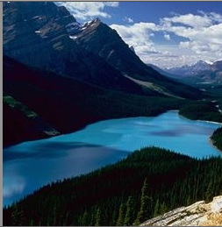
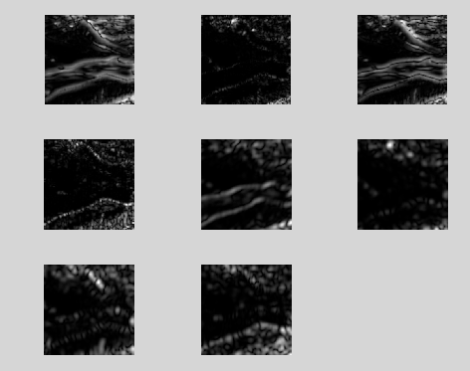
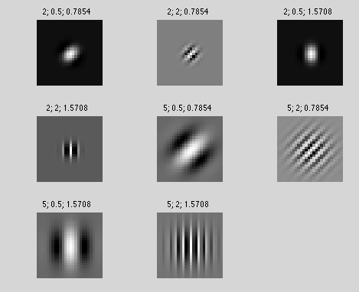
Gabor descriptor

Slide 5
Gabor descriptor
What filters to choose for the bank?
Should not have feature vector too big!!! Otherwise it will take forever to train the classifier
Scale: 3 scales
Orientation: counter clock in 45 degrees.
four directions: 0, 45, 90, 135
Thus, 4x3 = 12 filters in the filter bank

Slide 6
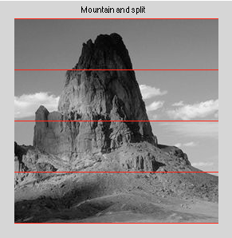
Gabor descriptor
PROBLEM: Too many values!
Break the image into smaller pieces - into 4 pieces;
8 bins in histogram for each filter and each piece of image
Total size of the feature vector: 12x4x8 =384

Slide 7
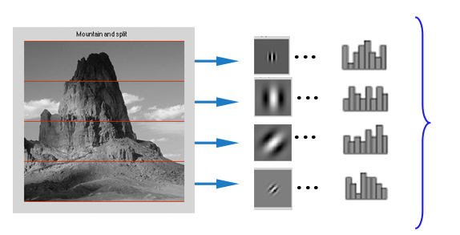
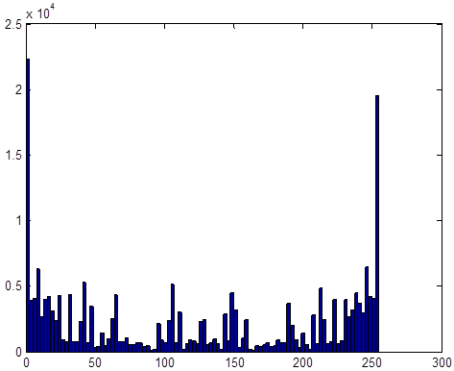
Gabor descriptor
384 beans total

Slide 8
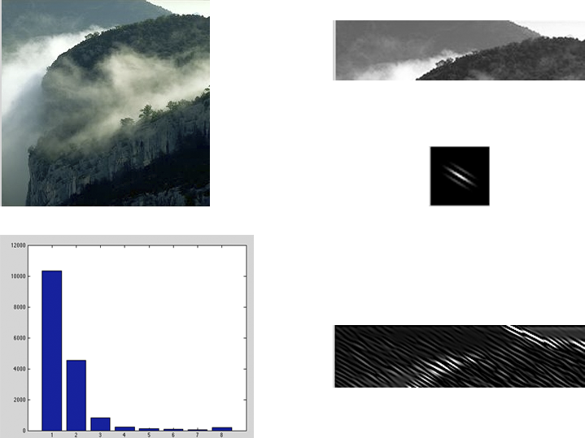
Gabor descriptor
Convolve with -->

Slide 9
Planning the network already
RBF (Radial Basis Function) network - must be faster to train
Shouldn't give worse results
Let's try to stick with mistery of Gaussian
Input layer: If Gabor features only nodes - 384 nodes (still reduced comparably to 768) + 256 CENTRIST + 256 Color Hist = 896
Nodes in the single hidden layer: 300 nodes
Output: Number of categories - 5

Slide 10
Pauline:
CENTRIST
descriptor

Slide 11
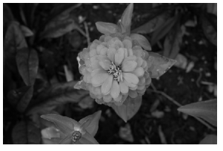
CENTRIST descriptor
Test image features:
Image of type uint => Convert to double
RGB color planes => Convert to grayscale
1880*2816 = more than 5.2 million pixels...
=> Downsize image
Grayscale downsized test image:

Slide 12
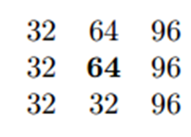

CENTRIST descriptor
function
compare
3x3 pixel surrounding
Decimal code for surrounding.
Code in [0 ; 255]
CENTRIST
Image
Image of the CT value for all pixels

Slide 13
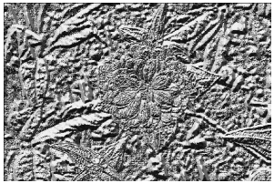
CENTRIST descriptor
Step 1
Need to use [ ] to ensure CT matrix display
470*704 = 331k pixels
Computation time = 36 seconds
CENTRIST
Image
Image of the CT
value for all pixels

Slide 14
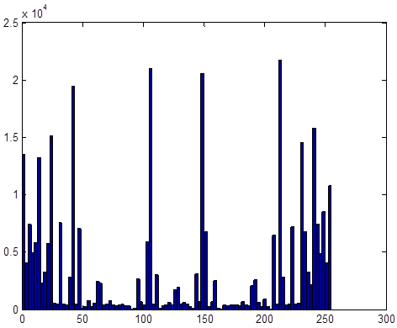
CENTRIST descriptor
Step 2
Use command "hist"
Goal:
Histogram
representative of
flowers...

Slide 15
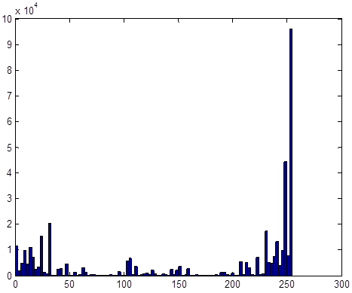
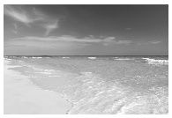
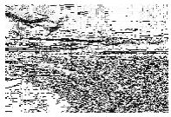
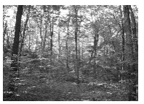
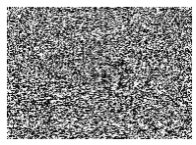
CENTRIST descriptor
Step 3: Other images histograms...
coast size 512*763 Comput. time = 43s
forest size 400*556 Comput. time = 24s

Slide 16
CENTRIST descriptor
Step 4: Compare results
Flower: peaks equally distributed
Coast: flat, mostly high values ~255
Forest: flat but higher, mostly low and high values
Flower
Coast
Forest

Slide 17
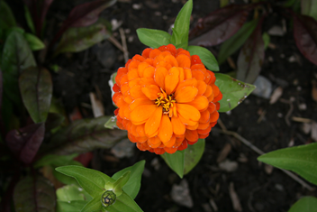
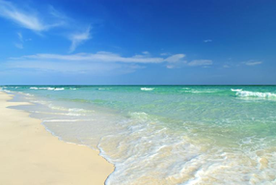
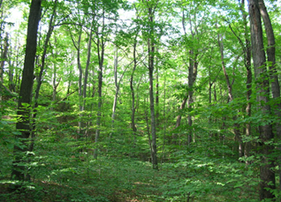
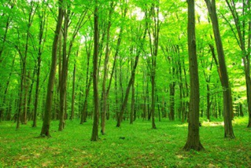
CENTRIST descriptor
TRAININGIMAGES
TEST IMAGE

Slide 18
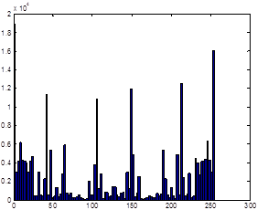
CENTRIST descriptor
Flower
Coast
Forest
TRAINING IMAGES
Errors (average mean distance):
With flower: 203
With coast: 227
With forest: 201
... not very good...
TEST IMAGE

Slide 19
CENTRIST descriptor
Ideas for future...
Try to "blur", or "average" a bit the CT images.
Try with another measure of distance for comparison
Try another way of coding loop call to compare function if possible

Slide 20
Piter:
Color histogram
descriptor

Slide 21
Color Histogram Descriptor
Algorithm Background:
A distance measure between two histograms has applications in:
- feature selection
- image indexing
- retrieval
- pattern classification
- clustering.
We propose a distance between sets of measurement values as a measure of dissimilarity
of two histograms with three versions of the univariate histogram, such as:
- nominal
- ordinal
- modulo
Their computational time complexities are Θ(b), Θ(b) and O(b2)
- where b is the number of levels in histograms.

Slide 22
Color Histogram Descriptor
Formulating Algorithm - Image Representation:
In this section we describe the:
- color feature spaces
- texture feature spaces
- representation of distributions (in these spaces).
Color:
- the perceived differences between individual nearby colors
- implement the Euclidean distances between the color coordinates.
Texture: Color is a purely pointwise property of images;
- involves a notion of spatial extent, a single point has no texture.
- Frequency-domain texture descriptors refer instead to the frequency;
content in a local neighborhood of the point.

Slide 23
Color Histogram Descriptor
Representation & Distributions:
Distribution of Features appearance of a region is described:
- the distribution of features
- individual feature vectors.
Histograms used as:
- non–parametric estimators of empirical feature distributions.
Issues:
For high–dimensional feature spaces a regular binning results in poor performance;
- coarse binning dulls resolving power
- fine binning leads to statistically insignificant sample sizes for most bins.
A partial solution is offered by :
- adaptive binning, whereby the histogram bins are adapted to the distribution.
- The binning is induced by a set of prototypes.

Slide 24
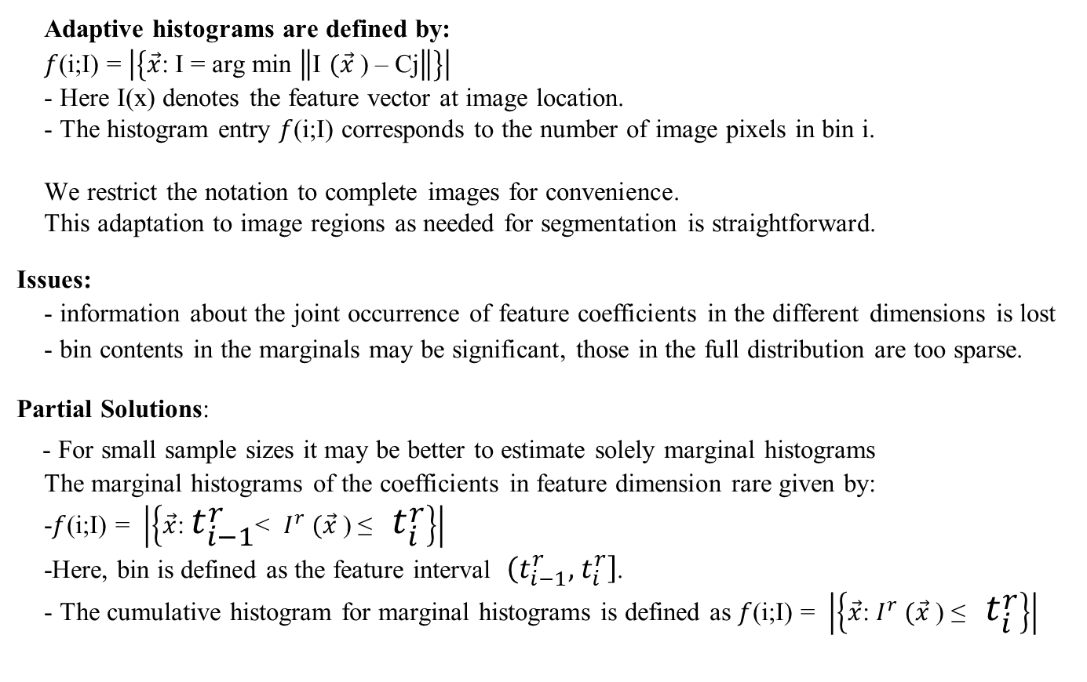
Color Histogram Descriptor
Adaptive histograms are defined by:
$f$(i;I) = $\left|\left\{\vec{x}\text{: }\text{I}\text{ = }\text{arg} \text{min} \left\|\text{I} (\vec{x} \text{) – }\text{Cj}\right\|\right\}\right|$
- Here I(x) denotes the feature vector at image location.
- The histogram entry $f$(i;I) corresponds to the number of image pixels in bin i.
We restrict the notation to complete images for convenience.
This adaptation to image regions as needed for segmentation is straightforward.
Issues:
- information about the joint occurrence of feature coefficients in the different dimensions is lost
- bin contents in the marginals may be significant, those in the full distribution are too sparse.
Partial Solutions:
- For small sample sizes it may be better to estimate solely marginal histograms
The marginal histograms of the coefficients in feature dimension rare given by:
-$f$(i;I) = $\left|\left\{\vec{x}\text{: }t_{i−1}^{r}\text{< }I_{}^{r} (\vec{x} \text{) ≤ }t_{i}^{r}\right\}\right|$
-Here, bin is defined as the feature interval $\left(t_{i−1}^{r}, \right.\left.t_{i}^{r}\right]$.
- The cumulative histogram for marginal histograms is defined as $f$(i;I) = $\left|\left\{\vec{x}\text{:} I_{}^{r} (\vec{x} \text{) ≤ }t_{i}^{r}\right\}\right|$

Slide 25
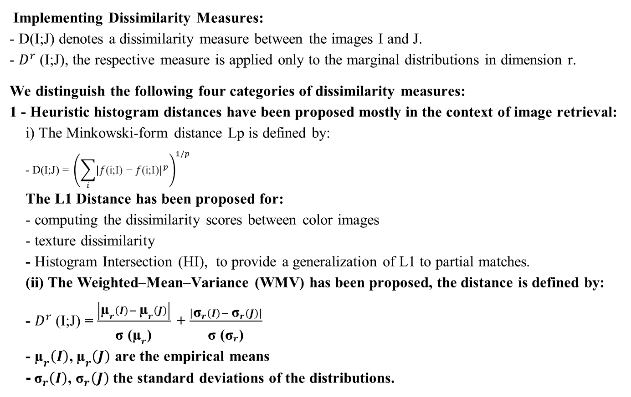
Color Histogram Descriptor
Implementing Dissimilarity Measures:
- D(I;J) denotes a dissimilarity measure between the images I and J.
- $D^{r}$(I;J), the respective measure is applied only to the marginal distributions in dimension r.
We distinguish the following four categories of dissimilarity measures:
1 - Heuristic histogram distances have been proposed mostly in the context of image retrieval:
i) The Minkowski-form distance Lp is defined by:
$$\text{− }\text{D}\text{(}\text{I}\text{;}\text{J}\text{) = }{\left(\sum_{i}{{\left|f\text{(}\text{i}\text{;}\text{I}\text{) − }f\text{(}\text{i}\text{;}\text{I}\text{)}\right|}^{p}}\right)}^{1/p}$$
The L1 Distance has been proposed for:
- computing the dissimilarity scores between color images
- texture dissimilarity
- Histogram Intersection (HI), to provide a generalization of L1 to partial matches.
(ii) The Weighted–Mean–Variance (WMV) has been proposed, the distance is defined by:
- $D^{r}$(I;J) = $\frac{\left|{\text{µ}}_{r}\left(I\right)− {\text{µ}}_{r}\left(J\right)\right|}{ _{\text{σ}\text{ (}{\text{µ}}_{r}\text{) }}}$+ $\frac{\left|{\text{σ}}_{r}\left(I\right)− {\text{σ}}_{r}\left(J\right)\right|}{ _{\text{σ}\text{ (}{\text{σ}}_{r}\text{) }}}$
- ${\text{µ}}_{r}\left(I\right)$, ${\text{µ}}_{r}\left(J\right)$ are the empirical means
-${ \text{σ}}_{r}\left(I\right)$, ${\text{σ}}_{r}\left(J\right)$the standard deviations of the distributions.

Slide 26
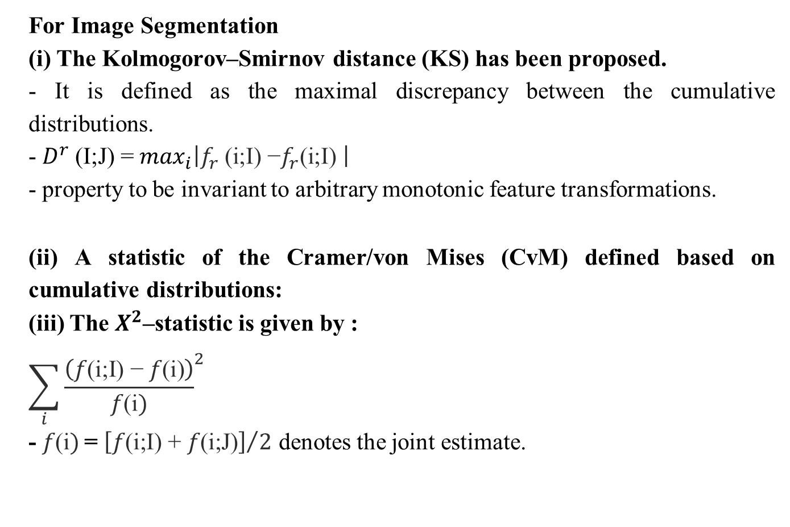
Color Histogram Descriptor
For Image Segmentation
(i) The Kolmogorov–Smirnov distance (KS) has been proposed.
- It is defined as the maximal discrepancy between the cumulative distributions.
- $D^{r}$(I;J) = $\max_{i}\left|f_{r} \text{(}\text{i}\text{;}\text{I}\text{) −}f_{r}\text{(}\text{i}\text{;}\text{I}\text{) }\right|$
- property to be invariant to arbitrary monotonic feature transformations.
(ii) A statistic of the Cramer/von Mises (CvM) defined based on cumulative distributions:
(iii) The $X^{2}$–statistic is given by :
$${\sum_{i}{\frac{\left(f\text{(}\text{i}\text{;}\text{I}\text{) − }f\text{(}\text{i}\text{)}\right)}{f\text{(}\text{i})}}}^{2}$$
- $f\text{(}\text{i})$= ${\left[f\text{(}\text{i}\text{;}\text{I}\text{) }\text{+ }f\text{(}\text{i}\text{;}\text{J}\text{)}\right]}/2$ denotes the joint estimate.

Slide 27
Results:
The classification performance has been estimated in a leave–one–out procedure for all combinations of parameters.
The classification results are summarized :
- Figure 1 (color)
- Figure 2 (texture), still working on it.

Slide 28
Coding Descriptor
clc; % Clear the command window.
close all; % Close all figures (except those of imtool.)
imtool close all; % Close all imtool figures.
clear; % Erase all existing variables.
workspace; % Make sure the workspace panel is showing.
fontSize = 20;
% Read in standard MATLAB color demo image.
rgbImage = imread('OrangeFlower.jpg');
[rows columns numberOfColorBands] = size(rgbImage);
subplot(2, 2, 1);
imshow(rgbImage, []);
title('Original Color Image', 'Fontsize', fontSize);
set(gcf, 'Position', get(0,'Screensize')); % Maximize figure.
redPlane = rgbImage(:, :, 1);
greenPlane = rgbImage(:, :, 2);
bluePlane = rgbImage(:, :, 3);

Slide 29
Coding Descriptor
% Let's get its histograms.
[pixelCountR grayLevelsR] = imhist(redPlane);
subplot(2, 2, 2);
bar(pixelCountR, 'r');
title('Histogram of red plane', 'Fontsize', fontSize);
xlim([0 grayLevelsR(end)]); % Scale x axis manually.
[pixelCountG grayLevelsG] = imhist(greenPlane);
subplot(2, 2, 3);
bar(pixelCountG, 'g');
title('Histogram of green plane', 'Fontsize', fontSize);
xlim([0 grayLevelsG(end)]); % Scale x axis manually.
[pixelCountB grayLevelsB] = imhist(bluePlane);
subplot(2, 2, 4);
bar(pixelCountB, 'b');
title('Histogram of blue plane', 'Fontsize', fontSize);
xlim([0 grayLevelsB(end)]); % Scale x axis manually.

Slide 30
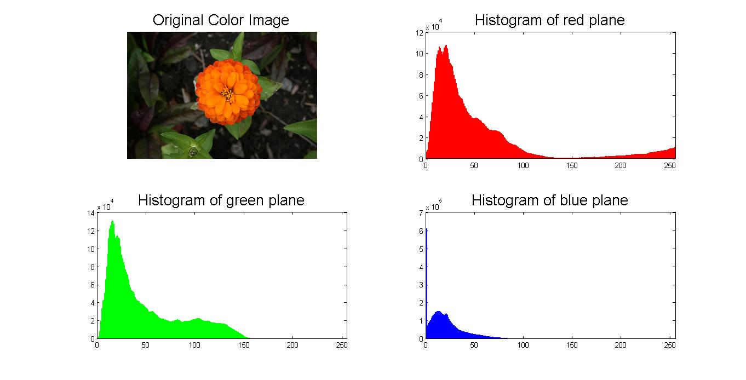
Color Histogram Descriptor

Slide 31
Coding Descriptor
function [h area labels] = invhist(im,weightoff)
%function [hist area labels] = invhist(im,weightoff)
% given an image, get an invariant color histogram
%INPUT
% im <-> image
% weightoff <-> 0: create invariant histogram 1: create traditional
% histogram (default 0)
% rez <-> number of bins in each color dimension
% (deault 5)
% OUTPUT
% h <-> 3d array containing the histogram
% area <-> shows relative contributions of different image pixels
% labels <-> to which 'label' does each pixel color correspond?

Slide 32
Coding Descriptor
if nargin<2
weightoff = 0;
end
if nargin < 3
rez = 5;
end
im = imread('OrangeFlower.jpg');
im = double(im);
im = im/max(im(:));
toohigh = find(im>1);
im(toohigh) = 1;
toolow = find(im<0);
im(toolow) = 0;
[ly lx lz] = size(im);
filt = [-1 0 1];
gim = .5*im(:,:,3) + ...
.5*im(:,:,2);
fim = im(:,:,1);
myim1 = im(:,:,1);
myim2 = im(:,:,2);
myim3 = im(:,:,3);
if weightoff
fx = 0*fim;
fy = 0*fim;
gx = 0*fim;
gy = 0*fim;
else
fx = conv2(fim,filt ,'same');
gx = conv2(gim,filt ,'same');
fy = conv2(fim,filt','same');
gy = conv2(gim,filt','same');
end

Slide 33
Coding Descriptor
test = (0==conv2(double(max(isnan(sum(im,3)),(0==sum(im,3)))),ones(5),'same'));
killa = zeros(ly,lx);
killa(6:end-5,6:end-5) = test(6:end-5,6:end-5);
ok = killa .* not(isnan(myim1.*myim2.*myim3)) .* (myim1.*myim2.*myim3 > 0) .* ...
not(isnan(fx)) .* not(isnan(fy)) .* not(isnan(gx)) .* not(isnan(gy));
area = 0*myim1;
labels = 0*myim1;

Slide 34
Coding Descriptor
h = zeros(rez,rez,rez);
for i=1:ly
for j=1:lx
if ok(i,j)
place_bin1 = max(1,ceil(rez*myim1(i,j)));
place_bin2 = max(1,ceil(rez*myim2(i,j)));
place_bin3 = max(1,ceil(rez*myim3(i,j)));
weight = fx(i,j)*gy(i,j)-fy(i,j)*gx(i,j);
weight = abs(weight);
if weightoff
weight = 1;
end
area(i,j) = weight;
labels(i,j) = (place_bin3-1)*rez*rez + (place_bin2-1)*rez + place_bin1;
h(place_bin1,place_bin2,place_bin3) = h(place_bin1,place_bin2,place_bin3)+weight;
end
end
end

Slide 35
Color Histogram Output Table
ans(:,:,1) =
162.3451 14.8270 0 0 0
18.8685 47.9392 23.4087 0 0
8.9383 13.8357 1.5157 0.0133 0
6.0077 36.2946 1.0821 0 0
1.2027 41.1247 15.7288 1.0230 0
ans(:,:,2) =
0.1076 0.0902 0 0 0
0.2665 24.7070 10.2587 0 0
0.0253 6.6795 10.4342 0.3830 0
0 8.2565 5.1790 0.0733 0
0 2.8292 13.8757 0.8957 0
ans(:,:,3) =
0 0 0 0 0
0 0.0888 0.0428 0 0
0 0.2082 2.8168 0.1724 0
0 0.0437 2.4997 0.6249 0.0006
0 0 1.7981 3.1453 0
ans(:,:,4) =
0 0 0 0 0
0 0 0 0 0
0 0 0.0799 0.0072 0
0 0 0.0887 1.0875 0.0216
0 0 0 0.7856 0.0894

Slide 36
Color Histogram Analysis
ans(:,:,5) =
0 0 0 0 0
0 0 0 0 0
0 0 0 0 0
0 0 0 0.0180 0
0 0 0 0.0001 0.1776

Slide 37
Concluding Update
Methods in Development Still to Apply
Actual Issues based on the cumulative histograms:
- their measures are defined only in one dimension
-cannot exploit the ground distance in the full feature space.
Employing BRD distance may improve:
- the dissimilarity measure between two distributions.

